Slide 1
Data Mining

Slide 2
Data Mining
Data is growing at a phenomenal rate. At the same time, users expect more sophisticated information
  A marketing manager is no longer satisfied with a simple listing of marketing contacts, but wants detailed information about customers past purchase behavior and prediction of future purchases
Data mining steps to solve such kinds of needs
Data mining uncover hidden information in a database
  Data Mining is a process that uses various techniques to discover hidden relevant information (knowledge or useful patterns) from heterogeneous & distributed historical data stored in large databases, warehouses & other massive information repositories

Slide 3
Data Mining Process Models
The DM process model describes procedures that are performed in each of its steps
  It is primarily used to plan, work through, and reduce the cost of any given project
There are different DM process model standards For example:
  The six step Cios et al. (2000) model,
  KDD process (Knowledge Discovery in Databases),
  CRISP-DM (Cross Industry Standard Process for Data Mining), and
  SEMMA (Sample Explore Modify Model Assess), etc.

Slide 4
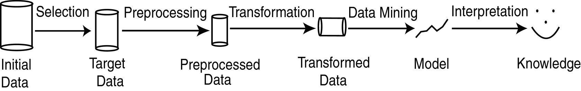
Stages in Data Mining
Selection: Obtain data from various sources
Preprocessing: Cleanse data and fills incomplete once
Transformation: Convert data from different sources into common format. Transform data into more usable new format
Data Mining: apply data mining techniques to obtain desired results
Interpretation/Evaluation: Present results to user in meaningful manner

Slide 5
Chapter III
Data Preprocessing

Slide 6
Data Preprocessing
Data Preprocessing: An Overview
  Data Quality
  Major Tasks in Data Preprocessing
Data Cleaning
Data Integration
Data Reduction
Data Transformation

Slide 7
Data Quality Measures
Before feeding data to DM we have to make sure the quality of data
A well-accepted multidimensional data quality measures are the following:
  Accuracy: correct or wrong, accurate or not
  Completeness: not recorded, unavailable, …
  Consistency: some modified but some not
  Timeliness: timely update?
  Believability: how trustable the data are correct?
  Interpretability: how easily the data can be understood?

Slide 8
Data Preprocessing
Today’s real-world databases are highly susceptible to noisy, missing, and inconsistent data due to their typically huge size and their likely origin from multiple, heterogeneous sources
  Low-quality data will lead to low-quality mining results
How can the data be pre-processed in order to help improve the quality of the data and, consequently, of the mining results?
How can the data be pre-processed so as to improve the efficiency and ease of the mining process?”

Slide 9
Data Preprocessing…
The major tasks in data preprocessing includes:
Data cleaning: it helps to get rid of bad data
  Fill in missing values, smooth noisy data, identify or remove outliers, and resolve inconsistencies
Data integration
  Integration of data from multiple sources (databases, data warehouses, or files) into a coherent data store
Data reduction: can reduce the data size by
  Dimensionality reduction
  Numerosity/size reduction
  Data compression
Data transformation
  Normalization
  Discretization

Slide 10
Data Preprocessing…
Data is often of low quality:
Data mining requires collecting great amount of data (available in warehouses or databases) to achieve the intended objective
In addition to its heterogeneous and distributed nature of data, data in the Real World Is Dirty and low quality
Why?
  You didn’t collect it yourself!
  It probably was created for some other use, and then you came along wanting to integrate it
  People make mistakes (typos)
  People are busy (“this is good enough”) to systematically organize carefully using structured formats

Slide 11
Data Preprocessing…
Data processing techniques, when applied before mining, can substantially improve the overall quality of the patterns mined and/or the time required for the actual mining
Incomplete, noisy, and inconsistent data are commonplace properties of large real world databases and data warehouses
There are many possible reasons for noisy data (having incorrect attribute values)
  The data collection instruments used may be faulty
  There may have been human or computer errors occurring at data entry
  Errors in data transmission can also occur
  Incorrect data may also result from inconsistencies in naming conventions or data codes used or inconsistent formats for input fields, such as date

Slide 12
Types of problems with data
Some data have problems on their own that needs to be cleaned:
  Outliers: misleading data that do not fit to most of the data/facts
  Missing data: attributes values might be absent which needs to be replaced with estimates
  Irrelevant data: attributes in the database that might not be of interest to the DM task being developed
  Noisy data: attribute values that might be invalid or incorrect. E.g. typographical errors
  Inconsistent data, duplicate data, etc.
Other data are problematic only when we want to integrate it
  everyone had their own way of structuring and formatting data, based on what was convenient for them
  How to integrate data organized in different format following different conventions

Slide 13
Case study: Government Agency Data
What we want:
ID | Name | City | State
1 | Ministry of Transportation | Addis Ababa | Addis Ababa
2 | Ministry of Finance | Addis Ababa | Addis Ababa
3 | Office of Foreign Affairs | Addis Ababa | Addis Ababa

Slide 14
Data Cleaning: Redundancy
  Duplicate or redundant data is data problems which require data cleaning
  Having a large amount of redundant data may slow down or confuse the knowledge discovery process
What’s wrong here?
ID | Name | City | State
1 | Ministry of Transportation | Addis Ababa | Addis Ababa
2 | Ministry of Finance | Addis Ababa | Addis Ababa
3 | Ministry of Finance | Addis Ababa | Addis Ababa

Slide 15
Data Cleaning: Incomplete (Missing) Data
Incomplete: lacking attribute values, lacking certain attributes of interest, or containing only aggregate data
  e.g., Occupation=“ ” (missing data)
Data is not always available
  E.g., many tuples have no recorded value for several attributes, such as customer income in sales data
What’s wrong here? A missing required field
ID | Name | City | State
1 | Ministry of Transportation | Addis Ababa | Addis Ababa
2 | Ministry of Finance |  | Addis Ababa
3 | Office of Foreign Affairs | Addis Ababa | Addis Ababa

Slide 16
Data Cleaning: Incomplete (Missing) Data
Missing data may be due to
  inconsistent with other recorded data and thus deleted
  data not entered due to misunderstanding and may not be considered important at the time of entry
  not register history or changes of the data
How to handle Missing data? Missing data may need to be inferred
  Ignore the missing value:
    This method is not very effective, unless the tuple contains several attributes with missing values.
    not effective when the percentage of missing values per attribute varies considerably
  Fill in the missing value manually: tedious + infeasible?

Slide 17
Data Cleaning: Incomplete (Missing) Data
  How to handle Missing data? con’t…
  Use a global constant to fill in the missing value:
    Replace all missing attribute values by the same constant e.g. “unknown”
    Although this method is simple it is not foolproof (incapable of going wrong or being misused)
  Fill automatically with the most probable value: calculate, say, using Expected Maximization (EM) algorithm

Slide 18
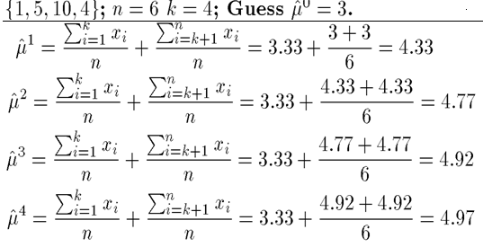
Predict missing value using EM
Solves estimation with incomplete data
  Obtain initial estimates for parameters
  Iteratively use estimates for missing data and continue until convergence
EM Example: out of six data items given known values= {1, 5, 10, 4}, estimate the two missing data items? Suppose that we initially guess mean = 3
The algorithm stop here since the last two estimates are only 0.05 apart. Thus, our estimate for the two items is 4.97.

Slide 19
Data Cleaning: Noisy Data
Noisy: containing noise, errors, or outliers
  e.g., Salary=“−10” (an error)
Typographical errors are errors that corrupt data
    Let say ‘green’ is written as ‘rgeen’
Incorrect attribute values may be due to
  faulty data collection instruments (e.g.: OCR)
  data entry problems
  data transmission problems
  technology limitation
  inconsistency in naming convention

Slide 20
Data Cleaning: How to catch Noisy Data
Pay someone to manually check all data
Sort data by frequency
  ‘green’ is more frequent than ‘rgeen’
  Works well for categorical data
Use constraints to Catch Corrupt Data
  E.g. Numerical constraints
    Weight can’t be negative
    People can’t have more than 2 parents
    Salary can’t be less than Birr 300
Use statistical techniques to Catch Corrupt Data
  Check for outliers (the case of the 8 meters man)
  Check for correlated outliers (“pregnant males”)
    People can be male
    People can be pregnant
    People can’t be male AND pregnant

Slide 21
Data Integration
Data integration combines data from multiple sources (database, data warehouse, files and sometimes from non-electronic sources) into a coherent store
Because of the use of different sources, data that is fine on its own may become problematic when we want to integrate it
Some of the issues are:
  Different formats and structures
  Conflicting and redundant data

Slide 22
Data Integration: Formats
Not everyone uses the same format
Dates are especially problematic:
  12/19/13
  19/12/13
  19/12/2013
  19-12-13
  Jan 19, 2013
  19 January 2013
  19th Jan. 2013
Are you frequently writing money as:
  Birr 200, Br. 200, 200 Birr, …

Slide 23
Data Integration: Inconsistent
Inconsistent data: containing discrepancies in codes or names, which is also the problem of Lack of standardization / naming conventions. e.g.,
  Age=“42” vs. Birthday=“13/03/2013”
  Some use “1,2,3” for rating; others “A, B, C”
Discrepancy between records
ID | Name | City | State
1 | Ministry of Transportation | Addis Ababa | Addis Ababa region
2 | Ministry of Finance | Addis Ababa | Addis Ababa administration
3 | Office of Foreign Affairs | Addis Ababa | Addis Ababa regional administration

Slide 24
Data Integration: different structure
What’s wrong here?
ID | Name | City | State
1 | Ministry of Transportation | Addis Ababa | AA
ID | Name | City | State
Two | Ministry of Finance | Addis Ababa | AA
Name | ID | City | State
Office of Foreign Affairs | 3 | Addis Ababa | AA

Slide 25
Data Integration: Conflicting Data
Detecting and resolving data value conflicts
  For the same real world entity, attribute values from different sources are different
  Possible reasons: different representations, different scales, e.g., American vs. British units
    weight measurement: KG or pound
    Height measurement: meter or inch

Slide 26
Handling Redundancy in Data Integration
Redundant data occur often when integration of multiple databases
  Object identification: The same attribute or object may have different names in different databases
  Derivable data: One attribute may be a “derived” attribute in another table, e.g., annual revenue, age
Redundant attributes may be able to be detected by correlation analysis
Careful integration of the data from multiple sources may help reduce/avoid redundancies and inconsistencies and improve mining speed and quality

Slide 27
Data Reduction Strategies
Data reduction: Obtain a reduced representation of the data set that is much smaller in volume but yet produces the same (or almost the same) analytical results
Why data reduction? — A database/data warehouse may store terabytes of data. Complex data analysis may take a very long time to run on the complete data set.
Data reduction strategies
  Dimensionality reduction,
    Select best attributes or remove unimportant attributes
  Numerosity reduction
    Reduce data volume by choosing alternative, smaller forms of data representation
  Data compression
    Is a technology that reduce the size of large files such that smaller files take less memory space and fast to transfer over a network or the Internet,

Slide 28
Data Reduction: Dimensionality Reduction
Dimensionality reduction
  Help eliminate irrelevant features and reduce noise
  Reduce time and space required in data mining
  Allow easier visualization
    Method: attribute subset selection
  One of the method to reduce dimensionality of data is by selecting best attributes
  Helps to avoid redundant attributes : that contain duplicate information in one or more other attributes
  Helps to avoid Irrelevant attributes: that contain no information that is useful for the data mining task at hand
        E.g., is students' ID relevant to predict students' GPA?

Slide 29
Dimensionality reduction Con’t…
Commonly used heuristic attribute selection methods:
  Best step-wise feature selection:
    The best single-attribute is picked first
    Then next best attribute condition to the first, ...
  Step-wise attribute elimination:
    Repeatedly eliminate the worst attribute
  Best combined attribute selection and elimination

Slide 30
Data Reduction: Numerosity Reduction
Different methods can be used, including Clustering and sampling
Clustering
  Partition data set into clusters based on similarity, and store cluster representation
Sampling
  obtaining a small sample s to represent the whole data set N
  Allow a mining algorithm to run in complexity that is potentially sub-linear to the size of the data
  Key principle: Choose a representative subset of the data using suitable sampling technique

Slide 31
Types of Sampling
Simple random sampling
  There is an equal probability of selecting any particular item
  Simple random sampling may have very poor performance in the presence of skew
Stratified sampling:
  Stratified sampling, which partition the data set and draw samples from each partition (proportionally, i.e., approximately the same percentage of the data)
Sampling without replacement
  Once an object is selected, it is removed from the population
Sampling with replacement
  A selected object is not removed from the population

Slide 32
Sampling: Stratified Sampling
Raw Data
Stratified Sample

Slide 33
Data Reduction: Data Compression
Two types of data compression:
    Lossless compression is a compression technique that does not lose any data in the compression process. lossless compression can reduce it to about half that size
    Lossy compression: To reduce a file significantly beyond 50%, one must use lossy compression. Lossy compression will strip some of the redundant data in a file. Because of this data loss, only certain applications are fit for lossy compression, like images, audio, and video.
Original Data
Compressed
Data
lossless
Original Data
Approximated
lossy

Slide 34
Data Reduction: Data Compression
Lossless and lossy compression have become part of our every day vocabulary largely due to the popularity of
  MP3 music files
    Compare it with WAV files
  JPEG image files
    Compare it with GIF or
  MP4 or MPEG video files
    Compare it with AVI files
These formats makes the resulting file much smaller so that several dozen music, image and/or video files can fit, for example, on a single compact disk, mobile phones, etc

Slide 35
Data Transformation
A function that maps the entire set of values of a given attribute to a new set of replacement values such that each old value can be identified with one of the new values
Methods for data transformation
  Normalization: Scaled to fall within a smaller, specified range of values
    min-max normalization
    z-score normalization
  Discretization: Reduce data size by dividing the range of a continuous attribute into intervals. Interval labels can then be used to replace actual data values
    Discretization can be performed recursively on an attribute using method such as
      Binning: divide values into intervals
      Concept hierarchy generation: organizes concepts (i.e., attribute values) hierarchically

Slide 36
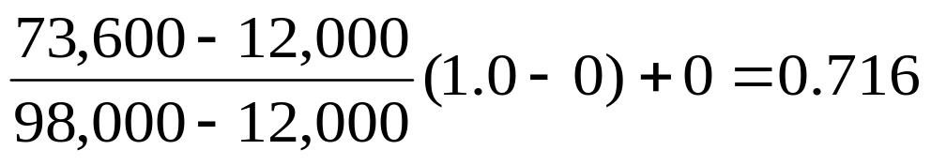

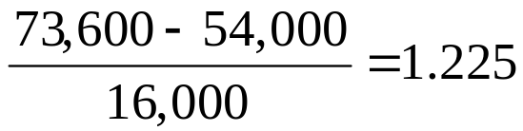
Normalization
Min-max normalization:
  Ex. Let income range $12,000 to $98,000 is normalized to [0.0, 1.0]. Then $73,600 is mapped to
Z-score normalization (μ: mean, σ: standard deviation):
  Ex. Let μ = 54,000, σ = 16,000. Then,

Slide 37
Simple Discretization: Binning
Equal-depth (frequency) partitioning
  Divides the range into N intervals, each containing approximately same number of samples
  Good data scaling
  Managing categorical attributes can be tricky

Slide 38
Binning Methods for Data Smoothing
For example, sorted data for price (in dollars): 4, 8, 9, 15, 21, 21, 24, 25, 26, 28, 29, 34
* Partition into equal-frequency (equi-depth) bins:
- Bin 1: 4, 8, 9, 15
- Bin 2: 21, 21, 24, 25
- Bin 3: 26, 28, 29, 34
* Smoothing by bin means:
- Bin 1: 9, 9, 9, 9
- Bin 2: 23, 23, 23, 23
- Bin 3: 29, 29, 29, 29
* Smoothing by bin boundaries:
- Bin 1: 4, 4, 4, 15
- Bin 2: 21, 21, 25, 25
- Bin 3: 26, 26, 26, 34

